Slide 1
Intelligence and the Assessment of Intelligence Numera Younus

Slide 2
Objectives
Explain the origin of intelligence testing
Describe term IQ and the ways of assessing intelligence
Discuss major theories of intelligence

Slide 3
What is Intelligence?

Slide 4
Intelligence is...
Intelligence is the capacity to understand the world, think rationally, and use resources effectively when faced with challenges
Based on the definitions, it is:
Rational thought and reasoning
The ability to act purposefully in an environment.
The ability to deal with situations, in an effective manner, within an environment.
Cognitive – Examples of cognitive ability: memory, perception, concept formation, problem solving, mental imagery, action, association, language and attention.
The ability to learning from experience
The ability to live and cope with the demands of daily life

Slide 5
“Mental activity directed towards purposive adaptation to, and selection and shaping of, real-world environments relevant to one’s life” (Sternberg, 1985)
“The aggregate or global capacity of the individual to act purposefully, to think rationally, and to deal effectively with the environment” (Wechsler, 1958)

Slide 6
Both genetics and the environment play a role in determining intelligence.
It is important to note that genetics and the environment interact to determine exactly how inherited genes are expressed.
Evidence of genetic influences:
Twin studies suggest that identical twins IQ's are more similar than those of fraternal twins (Promin & Spinath, 2004).
Siblings reared together in the same home have IQ's that are more similar than those of adopted children raised together in the same environment (McGue & others, 1993).

Slide 7
Evidence of environmental influences:
Identical twins reared apart have IQ's that are less similar than identical twins reared in the same environment (McGue & others, 1993).
School attendance has an impact on IQ scores (Ceci, 2001).
Children who are breastfed during the first three to five months of life score higher on IQ tests at age 6 than same-age children who were not breastfed (Reinberg, 2008).

Slide 8
Genetics
Heritability estimates for IQ is about .50 in a population
Environment
Like other traits, IQ is changeable
Educational experiences affect IQ
IQ scores have increased over the years (nutritional factors, increasing access to information)

Slide 9
Theories of Intelligence

Slide 10
Charles Spearman: General Intelligence
General intelligence, also known as ‘g’ factor, refers to the existence of a general intelligence that influences performance on mental ability measures
Those who hold this view believe that intelligence can be measured and expressed by a single number, such as an IQ score.
The idea is that this underlying general intelligence influences performance on all cognitive tasks.
Notes:
Mental Ability: the power to learn or retain knowledge; in law, the ability to understand the facts and significance of your behavior;
possession of the qualities (especially mental qualities) required to do something or get something done

Slide 11
Raymond Cattell: Two-Factor Theory
Raymond Cattell (1963) believed that ‘g’ is composed of fluid and crystallized intelligence.
Fluid Intelligence
The degree of flexibility in thinking and the ability to reason abstractly
The ability to solve novel problems, usually measured by nonverbal tasks.
Considered to be influenced more by genetics and brain physiology than environment.
Examples of the use of fluid intelligence include solving puzzles and coming up with problem-solving strategies.

Slide 12
Raymond Cattell: Two-Factor Theory
Crystallized Intelligence
Involves knowledge that comes from prior learning and past experiences.
Dependent upon education and cultural assimilation
Situations that require crystallized intelligence include reading comprehension and vocabulary exams.

Slide 13
Howard Gardner: Multiple Intelligences
His theory describes eight distinct intelligences that are based on skills and abilities that are valued within different cultures.
Gardner argues that rather than asking “How smart are you?” we should be asking a different question: “How are you smart?”

Slide 14
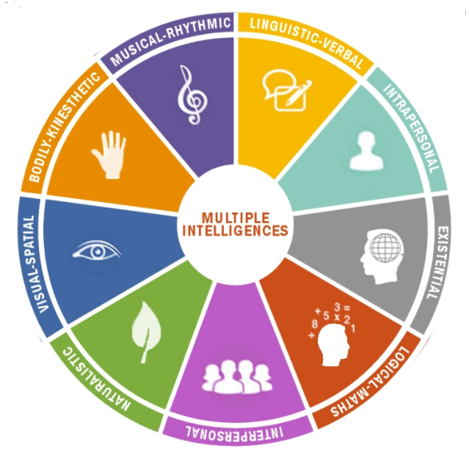

Slide 15
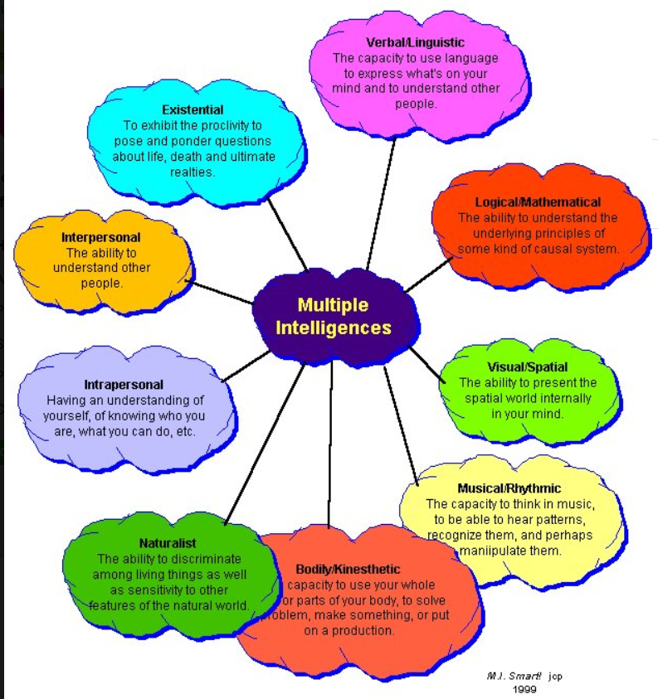

Slide 16
Assessment of Intelligence

Slide 17
Purposes of Intellectual Assessment:
Psycho-educational Assessment
Identification & placement of special-needs students.
Predict academic and work performance.
Evaluate for Mental Retardation & Learning Disabilities.
Evaluate for neurological impairment.
Career Counseling.
Research.

Slide 18
History of Intelligence Testing
Francis Galton, cousin of Charles Darwin, studied family trees to try to demonstrate a hereditary basis for intelligence.
Early intelligence tests measured sensory-motor functions, such as reaction time.
1905: Alfred Binet & Theodore Simon developed a test to identify mentally retarded students in Paris, France.
1916: Lewis Terman published the first version of the Stanford-Binet Intelligence Scale.
1939: David Wechsler published the Wechsler-Bellevue Scale.

Slide 19
Alfred Binet wanted to figure out how to help students who were struggling in school. Binet's idea was simple: if older kids could do certain tasks better than younger kids, these tasks could help find the smarter and less smart kids in the same age group.
Binet tested students labeled as "bright" or "dull" by their teachers. If a task was easy for the bright kids but hard for the dull ones, he kept it as a good test question. With this method, he made a test that could tell the bright from dull students and later even distinguish between kids of different ages.
Binet gave kids a score based on their "mental age," which is the age at which a person's performance is average. For instance, if an 8-year-old usually got 45 questions right, anyone who got 45 right would have a mental age of 8. So, a 20-year-old and a 5-year-old could both have a mental age of 8 if they got the same number of questions right.
But just using mental age had a problem. It didn't let us compare people of different ages very well. Hence "intelligence quotient" or IQ was devised. It's a score that considers both mental age and actual age. The formula used to be (MA/CA) × 100, where MA is mental age, and CA is chronological age.
For example, let's say an 18-year-old does as well as a 20-year-old (MA=20). Their IQ would be (20/18) × 100 = 111. But a 5-year-old doing as well as a 7-year-old (MA=7) would have a higher IQ: (7/5) × 100 = 140.
If someone's mental age matches their actual age, their IQ is 100. If their mental age is lower, their IQ is less than 100. This way, we can compare intelligence across different ages.

Slide 20
Intelligence Quotient (IQ)
It is a mathematical formula that is supposed to be a measure of a person's intelligence.
The term "intelligence quotient," or IQ, was first coined in the early twentieth century by a German psychologist named William Stern.
Since that time, intelligence testing has emerged as a widely used tool that has led to the development of many other tests of skill and aptitude.

Slide 21
Intelligence Quotient (IQ)
IQ= Mental age/Chronological Age X 100
IQ ratio enables direct comparison of children of different ages

Slide 22
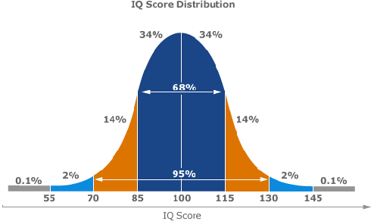
IQ Range | Classification
Over 140 | Genius or almost genius
120 - 140 | Very superior intelligence
110 - 119 | Superior intelligence
90 - 109 | Average or normal intelligence
80 - 89 | Dullness
70 - 79 | Borderline deficiency in intelligence
Under 70 | Feeble-mindedness

Slide 23
Group Intelligence Tests
Paper-and-Pencil examinations frequently used to screen applicants & identify those in need of more thorough evaluations.
WWI: Army Alpha & Beta Tests.
Wonderlic Personnel Test: 50-item instrument that provides a quick estimate of cognitive ability. Popular in organizational settings to screen job applicants or make placement decisions.
Examples of items: analogies, definitions, logical reasoning, math, spatial reasoning,

Slide 24
The Wechsler Scales
Wechsler Intelligence Scale for Children
(WISC-R)
Wechsler Adult Intelligence Scale (WAIS)
Wechsler Preschool and Primary Scale of Intelligence (WPPSI)

Slide 25
The Wechsler Scales
Verbal Subtests
Information
Vocabulary
Arithmetic
Similarities
Comprehension
Digit Span
Performance Subtests
Picture Completion
Picture Arrangement
Block Design
Object Assembly
Digit Symbol

Slide 26
VERBAL SUBTESTS
Information: culturally acquired information
Vocabulary: general verbal intelligence
Arithmetic: numerical reasoning
Similarities: abstract reasoning
Comprehension: social norms
Digit Span: short term memory
PERFORMANCE SUBTESTS
Picture Completion: visual concentration and nonverbal general information
Picture Arrangement: ability to plan, interpret and anticipate in social context
Block Design: perceptual organization, spatial visualization and abstract concentration
Object Assembly: visual motor organ., synthesis
Digit Symbol: visual memory

Slide 27
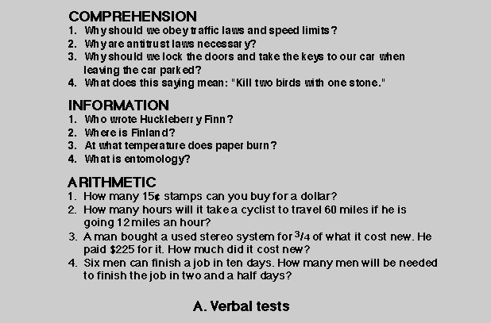

Slide 28
Similarities
In what way are an orange and a banana alike?
How are whales and lions similar?
How are anger and delight similar?
"In what way are RED and BLUE alike?"

Slide 29

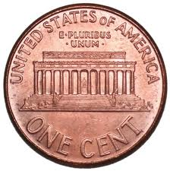
Vocabulary
"What is a car?"
Bed
Ship

Slide 30
Digit Span
Demonstrate

Slide 31
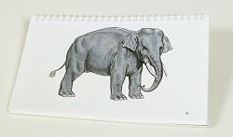
Picture Completion

Slide 32
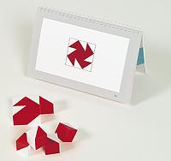
Block Design

Slide 33
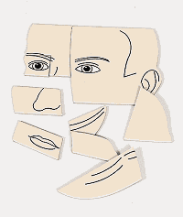
Object Assembly

Slide 34
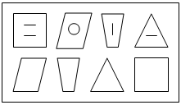
Digit Symbol Coding

Slide 35
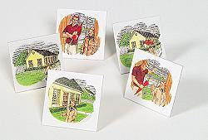
Picture Arrangement

Slide 36
Wechsler Scales: Use
Estimation of general intelligence (correlates with academic success and occupational status)
Examine the discrepancy in performance between verbal and performance subtests
Examine the variability among subtests

